Slide 1
Fun Cub Scout Meeting
Get Together and Have Fun!
Video Conference & PowerPoint
Notes:
If you need access to a remote service, every District has a Lifesize account. Just call your District Executive! He/She can give you the link and help you the first time.
If a parent has an account like ZOOM, get them to help you.

Slide 2
Fun Cub Meeting Agenda
Items | Time | Notes
Welcome and Open | 3 min | Pledge of Allegiance.
Meeting Manners | 3 min | Mute, Chat,
Round Robin Hello Feedback Practice | 5 min | Who has “--------------”
Eye Spy | 10 min | Longer or shorter depending
Cub Scout Essentials | 10 min | Depends on the number of Scouts on the call.
Good Turn Daily | 2 min
Simon Says | 5 min | Don’t always stay in the chair!
Outdoor Code | 5 min
Scoutmaster Minute and Close | 5 min | Meeting Evaluation and Closing.
If they are having fun – do it longer.
If they don’t like it – move on.
Have them give you FEEDBACK using reaction buttons.

Slide 3
Welcome Cub Scouts!
How are you? Let’s have some fun.
Pack or Den # Here

Slide 4
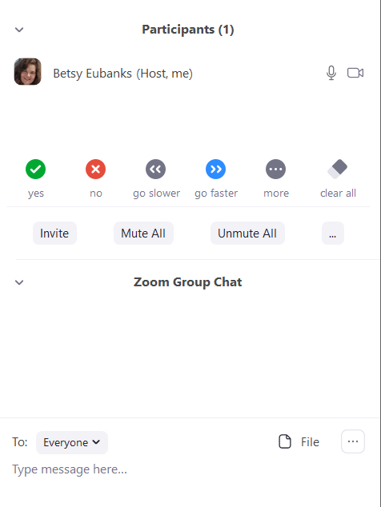
A Scout is Courteous
Find your MUTE.
Mute yourself.
Find your CHAT. Send a message to everyone!
Notes:
Before you start, go over some technology use things but keep it simple.
Use the Share Screen to have them all find MUTE and CHAT.
Type a message to everyone!
Have them type something back.
Show everyone what to do if they are talking and you can’t hear them “wave frantically”
As a leader, know how to mute and unmute people.

Slide 5
Pledge of Allegiance
Notes:
You can lead this, or have one Scout do it with everyone else on MUTE.

Slide 6
No = Fist Yes = 5 Fingers
Yes & No
Did you ride an elephant today?
Did you breathe today?
Notes:
Explain that they answer questions with a “YES” or “NO” by showing a Fist or 5 Fingers. Show them with your hand.
Have them practice with a couple of goofy questions.
“Did anyone ride a elephant today?” everyone should answer “NO”
“Did everyone breath air today?” Hopefully, you get all “YES”

Slide 7
Who Has…. Yes = 5 fingers No = 0 fingers
Been on a hike in the last 3 days?
Used a band aid during May?
Cooked anything last week?
Watched any good movies or read a good book? (What was it?)
Gotten a new pet?
Notes:
Teach them how to give screen input with this simple method.
Yes = 5 fingers No = 0 fingers
OR if a lot of scouts, have them use the YES and NO buttons.
You can Change the questions to ask what you think your Scouts would like. These are ideas.

Slide 8
Let’s Play Eye Spy!
Notes:
Let them know what kind of eye spy game you are playing.
Categories: Challenge the Cubs to find categories of things:
How many bugs?
Animals?
Have them play “Eye Spy”
Player A says; “I spy with my little eye, something _____________.” And gives a clue.
Next player asks questions to figure it out. They can keep asking questions if the answer is “yes”. If “no”, the next player gets to ask the question.
Kim’s Game
Show the slide for 10 seconds
Have the Cubs write out things they remember
Then bring the slide up again and have them compare lists. You can play for points.
1 pt for each thing
And 2 points if you see something no one else saw

Slide 9
Eye Spy Variations
Categories: Challenge the Cubs to find categories of things:
How many bugs?
Animals?
Have them play “Eye Spy”
Player A says; “I spy with my little eye, something _____________.” And gives a clue.
Next player asks questions to figure it out. They can keep asking questions if the answer is “yes”. If “no”, the next player gets to ask the question.
Kim’s Game
Show the slide for 10 seconds
Have the Cubs write out things they remember
Then bring the slide up again and have them compare lists. You can play for points.
1 pt for each thing
And 2 points if you see something no one else saw
Notes:
This is in the notes of the Eye Spy slide.

Slide 10
Categories Eye Spy Game
You have 15 seconds
How many bugs can you find?
Notes:
Modify this slide depending on what you decide to have them find for the first round.
You can make the time shorter, or longer, depending on how it works with your Scouts.
If they play another round, just tell them what you want them to do or find, depending on the game.

Slide 11
Notes:
Directions – Eye-Spy Fun
Challenge the Cubs to find categories of things:
How many bugs?
Animals?
Buttons?
Things that live in water?
Keys?
Letters?
Anything you want to ask.
Have them play “Eye Spy”
Player A says “I spy with my little eye, something _____________.” And gives a clue.
Next player asks questions to figure it out. They can keep asking questions if the answer is “yes”. If “no”, the next player gets to ask the question.

Slide 12
Game
How many bugs did you find?
Notes:
Have Scouts tell you, then tell them how many there were!

Slide 13
Notes:
Directions – Eye-Spy Fun
Challenge the Cubs to find categories of things:
How many bugs?
Animals?
Buttons?
Things that live in water?
Keys?
Letters?
Anything you want to ask.
Have them play “Eye Spy”
Player A says “I spy with my little eye, something _____________.” And gives a clue.
Next player asks questions to figure it out. They can keep asking questions if the answer is “yes”. If “no”, the next player gets to ask the question.

Slide 14
Categories Eye Spy Game
You have 15 seconds
How many animals can you find?
Notes:
Modify this slide depending on what you decide to have them find for the first round.
You can make the time shorter, or longer, depending on how it works with your Scouts.
If they play another round, just tell them what you want them to do or find, depending on the game.

Slide 15
Notes:
How many non-insect animals can you find?

Slide 16
Fist of 5 Voting Explained
Licorice
Strawberry
Chocolate
Notes:
This is teaching them another way to give you feedback, which you can use in a remote meeting OR in a live meeting. You get more information than a simple yes or no, so you can make a decision from the input. You need to explain it, and try a couple of questions to have them practice.
5 – Yea! Enthusiastic YES! (if ice cream – it is a favorite)
4 – Pretty good – OK. (if ice cream – like it sometimes, depends)
3 – No opinion, happy to do anything others want. (if ice cream, would eat it ok but not my favorite)
2 – Some reservation. (if ice cream, would eat it if that is the only thing available)
1 – Not happy, don’t like it, NO! (if ice cream, would not eat it at all)
Slide is animated so you can practice. Use this case:
I am going to buy an ice cream flavor for a meeting. What flavor should I get? Vote on these flavors.

Slide 17
Another Round or Move On?
Notes:
Now that they know how to give your feedback, ask if they want to do another Eye Spy Round with a different picture.
5 – Yea! Enthusiastic YES!
4 – Pretty good – OK.
3 – No opinion, happy to do anything others want.
2 – Some reservation.
1 – Not happy, don’t like it, NO!

Slide 18
Game
This picture is trickier!
How many wheeled vehicles can you find?
Notes:
Have Scouts tell you, then tell them how many there were!

Slide 19
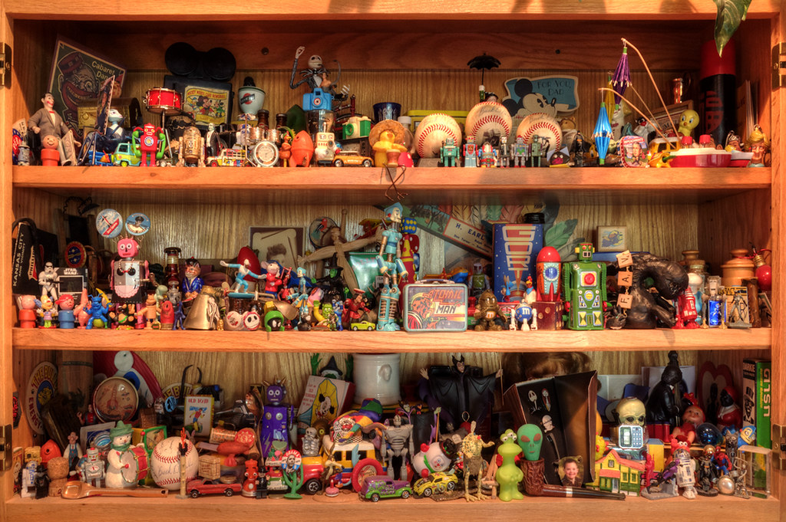
Notes:
I hope I found them all, but there is always a chance a Cub will spot one I missed!

Slide 20
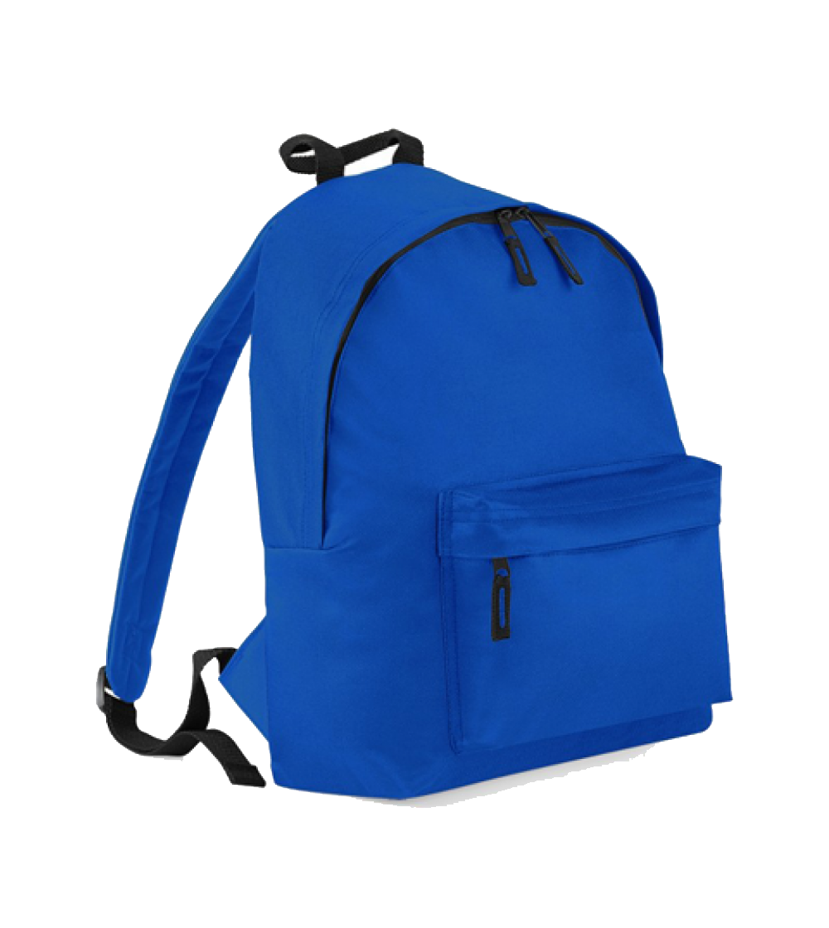
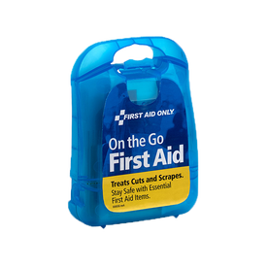
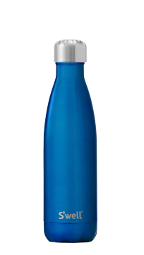
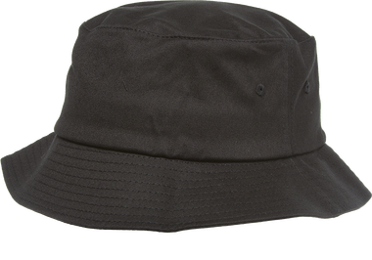
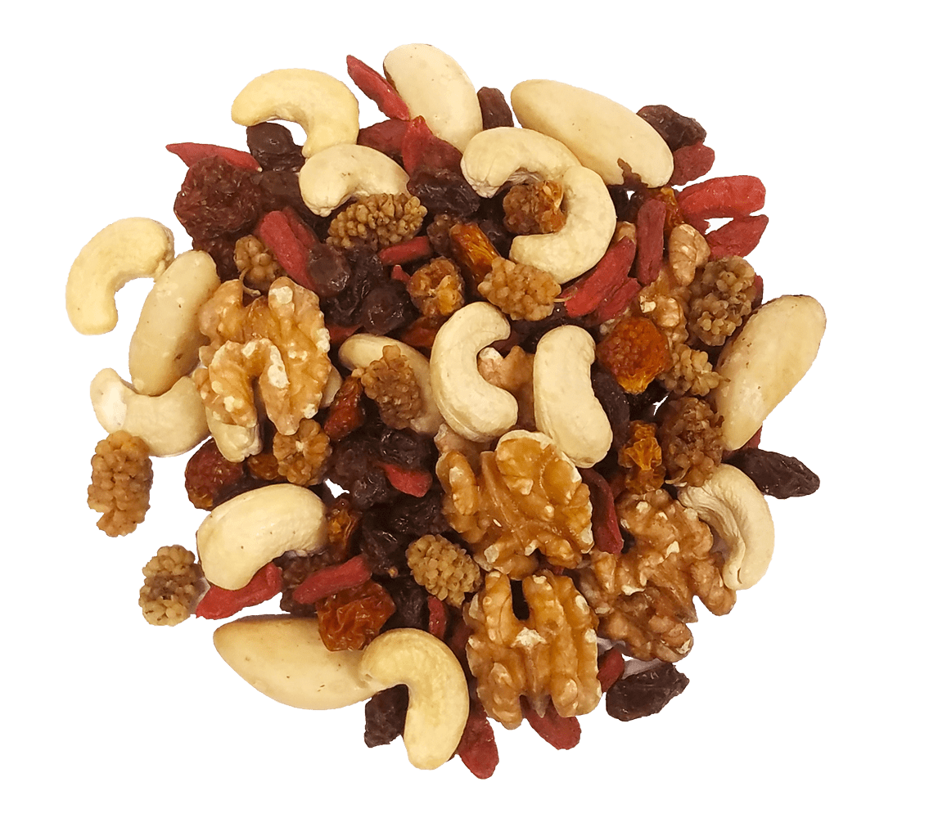
Kim’s Game – 7 Essentials
First review the 6 daypack essentials.
Water Bottle
Flashlight
Whistle
First Aid Kit
Sun Protection
Trail Food
Get Ready: Look at the next slide for 10 seconds. What is missing!
Show their essentials kit next time
Notes:
Introduce this by saying you hope they are out HIKING some with their family. They should always have their essentials.
Have Scouts take turns talking about the essentials. You can ask them questions:
What is your favorite trail snack?
What kind of water bottle do you like? Why?
Do you have a hat you think works best?
Etc.
Another good question – what else do they like to keep in their Daypack?
After you talk to them, play “what’s missing” which is really a variation of Baden’ Powell’s favorite game, called Kim’s Game.
Have them look at the next slide for 10 seconds (longer for younger scouts), and write down what is missing.

Slide 21
What is Missing?
Notes:
Flashlight
First Aid Kit

Slide 22
Another Round or Move On?
Notes:
Now that they know how to give your feedback, ask if they want to do another Eye Spy Round with a different picture.
5 – Yea! Enthusiastic YES!
4 – Pretty good – OK.
3 – No opinion, happy to do anything others want.
2 – Some reservation.
1 – Not happy, don’t like it, NO!

Slide 23
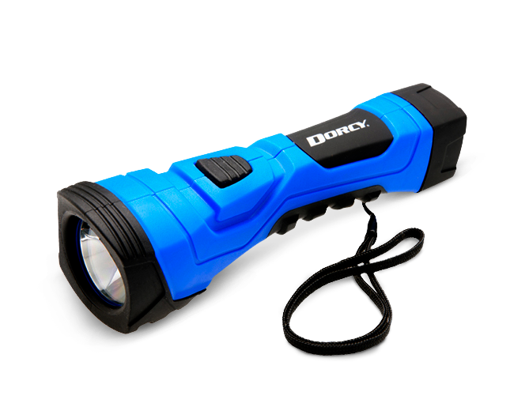
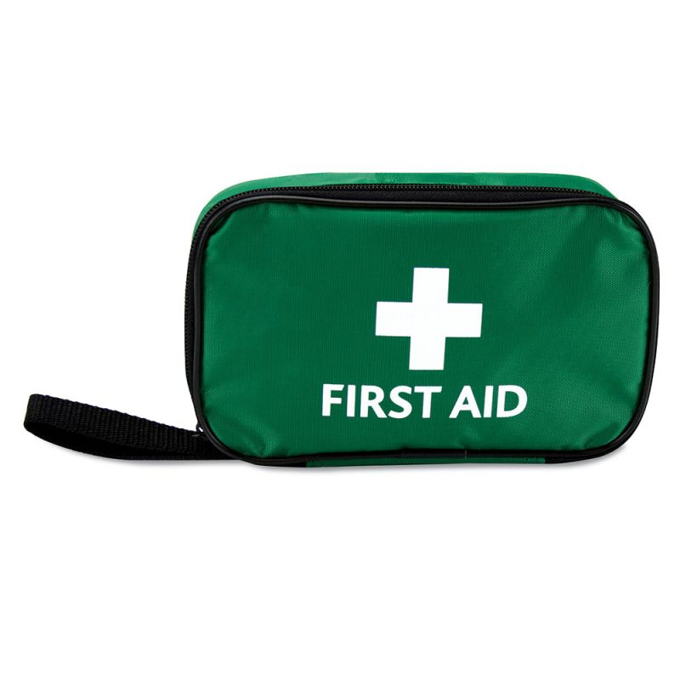
What is Missing 2?
Notes:
Whistle

Slide 24
Three Minutes
What Can You DO?
Share Ideas
When music stars – go do something helpful!
Notes:
A Good Turn Daily doesn’t stop because you are stuck at home. It doesn’t take long to help someone. Even three minutes is a start! What ideas do they have of something they can run and do in 3 minutes? Help them think of something, then hit the play button to start to music. Keep the call active!
They should all come back as close to the 3 minute as possible, then ask how it went!

Slide 25
Get Ready to Move!
Notes:
Make sure they have clear field to move arms, get up, sit down, go down on the floor.
Make this very ACTIVE and also GOOFY since they can see each other. This is an elimination game, but you can modify play so that you start over once half the group is out, or play until you have a winner. Decide what works for your Scouts. This should be fast and fun.
Play for about 5 minutes.
Ideas:
Touch your elbows together.
Touch your nose with your tongue (or try to)
Touch your hands behind your back, one arm over head, one arm down.
Stand on one foot
Do Vulcan Hand Sign for Live Long and Prosper (you may need to demonstrate this)
Jump up and down
Jumping Jacks
Touch you thumb to each finger repeat
Make a face to show you don’t like the food
Make a face to show you are really bored
Cross your eyes
Etc – your ideas here!

Slide 26
Disappearing Words
Let’s learn the Outdoor Code together.
You may be “Buddies” read together, and mute other scouts, as they see how far they can get OR;
Simply take turns each time.
After every round, more words will disappear!
Notes:
You need to explain how disappearing words work, and there is an easy practice slide for this you can use or not depending on the Scouts you have.
Disappearing words is a good way to learn something such as the Oath, Law, or the Outdoor Code.
You may be “Buddies” read together, and mute other scouts, as they see how far they can get OR;
Simply take turns each time.
The practice slide and the Outdoor Code are animated – each click, one or two word will disappear.

Slide 27
Disappearing Words Practice
Six
slippery
snails
slid
slowly
seaward.

Slide 28
As
an
American,
I
will
do
my
best
to -
Be
clean
in
my
outdoor
manners.
Be
careful
with
fire.
Be
considerate
in
the
outdoors.
Be
conservation
minded.
The Outdoor Code
Notes:
Nice job!

Slide 29
Adventure Requirements
Tigers in the Wild
1 Name and collect the 6 essentials.
3a Talk about being clean in outdoor manners
Call of the Wild (Wolf)
3A – Recite the Outdoor Code
Paws on the Path
1 Put together 6 Essentials
Bear Necessities
You could adapt to cover 2 – make a list of what to take on a planned outing.
Webelos Walk about
3 Recite the Outdoor Code from Memory (Partial) Leave No Trace also need to be covered.
Outdoor Adventurer
5 Recite the Outdoor Code and Leave No Trace from Memory. Talk about how to practice these on an outing.
Notes:
Nice job! And you also finished some things on adventure requirements, so we will get these recorded.

Slide 30
Fun Cub Scout Meeting
Leader Minute
What is coming next?
Notes:
Wrap-up the meeting with a Leader Reflection and get feedback. Did they like it? What would they like to do?
Get ideas!

Slide 31
Fun Cub Scout Meeting
Get Together and Have Fun!
Betsy Eubanks
(Eubanks.betsy@gmail.com
Notes:
If you need access to a remote service, every District has a Lifesize account. Just call your District Executive! He/She can give you the link and help you the first time.
If a parent has an account like ZOOM, get them to help you.

